Slide 1

Trabalho e educação: fundamentos ontológicos e históricos
Grupo 4 – Apresentação imagética

Slide 2
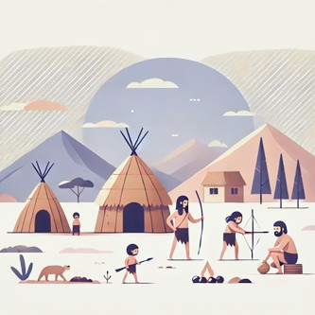
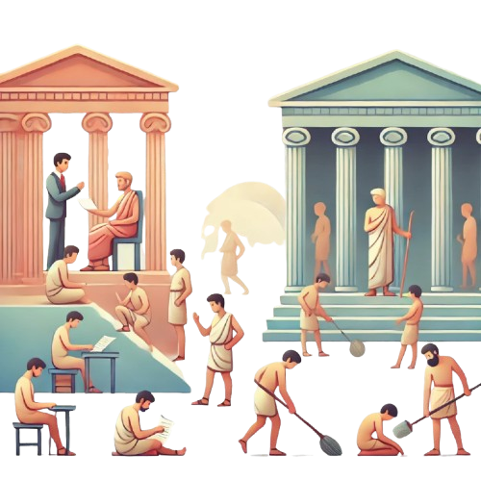

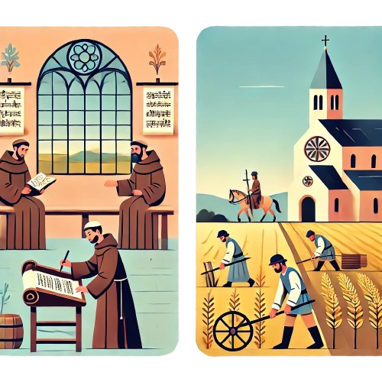




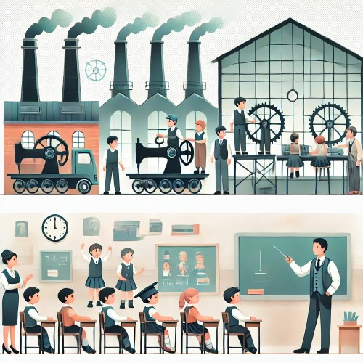
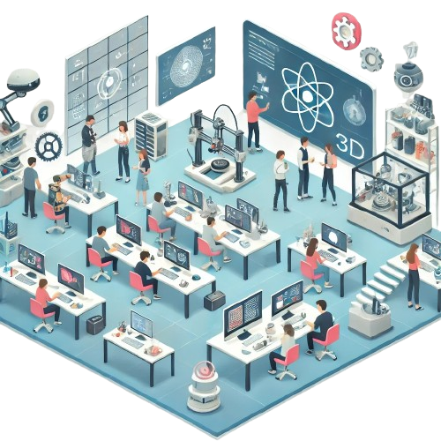

Slide 3
25%
Jupiter
Jupiter is a gas giant and the biggest planet in the Solar System

Slide 4
25%
Jupiter
Jupiter is a gas giant and the biggest planet in the Solar System

Slide 5
25%
Jupiter
Jupiter is a gas giant and the biggest planet in the Solar System

Slide 6
25%
Jupiter
Jupiter is a gas giant and the biggest planet in the Solar System

Slide 8
Grupo 4
Elaine Christina de Morais Carvalho Monteiro Felipe Franco Pinheiro
Francielli Gai
Maria Eduarda de Miranda Ramos
Yann Lucas Saito da Luz

